Slide 1
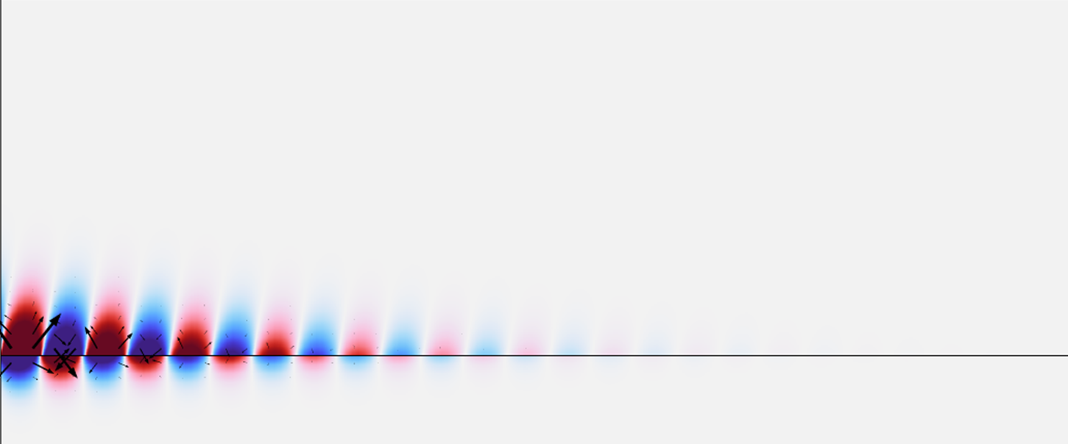


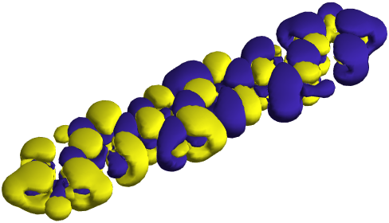
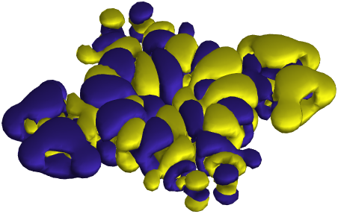
Mhamad Hantro – Gilles Rosolen – Colin Van Dyck
Modeling
Quantum Emitters
in
Nanoplasmonic Structures
Assessing the validity
of the
point-dipole approximation
29/05/2024
Micro- and Nanophotonic Materials Group
Research Institute for Materials Science and Engineering
Service Chimie Physique Théorique

Slide 2

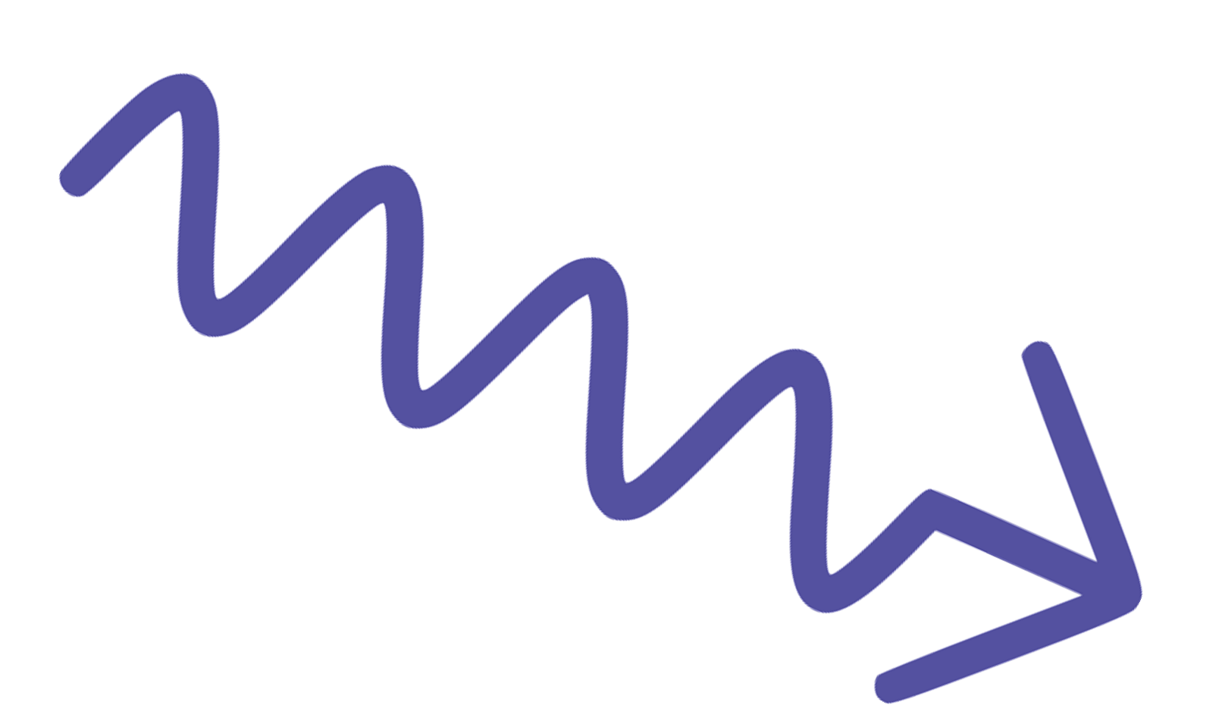
Spontaneous emission
Enhanced
?
Plasmons
Initial state
Final state
Matter
Two level system
Electromagnetic
Vacuum
Density of States

Slide 3

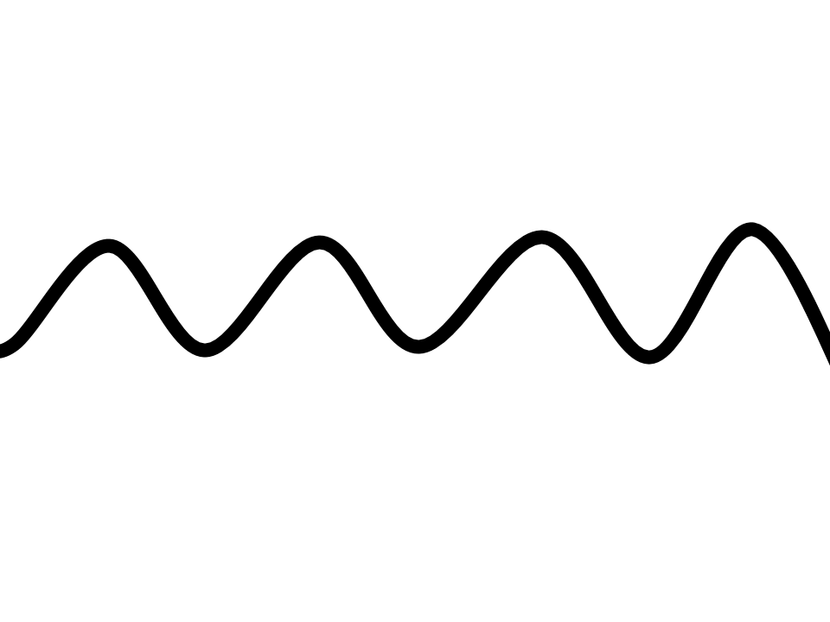


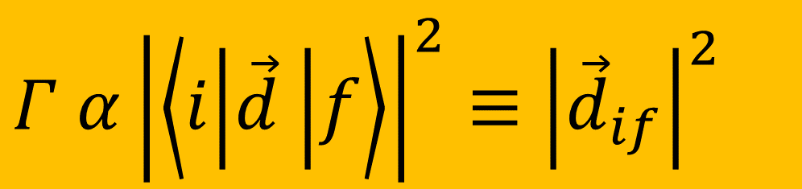


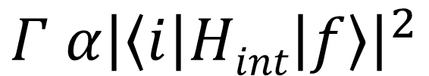
Decay Rate: In Vacuum
$$Γ α{\left|\left\langle i | Hint | f\right\rangle \right|}^{2}$$
$$Hint=\vec{d}.\vec{E}+\vec{m}.\vec{B}+ \overset{̿}{Q}∇E+ …$$
2 nm
Approximately constant
$$ⅇ^{i\vec{k}⋅\vec{r}}$$
$$(\vec{k}⋅\vec{r}\sim 0)$$
550 nm
$$(ⅇ^{i\vec{k}⋅\vec{r}}\sim 1)$$
$Γ α{\left|\left\langle i | \vec{d} | f\right\rangle \right|}^{2}≡$ ${\left|{\vec{d}}_{if}\right|}^{2}$
Point-Dipole Approx

Slide 4
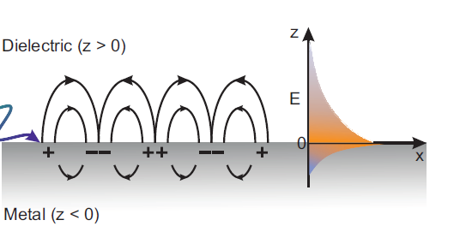
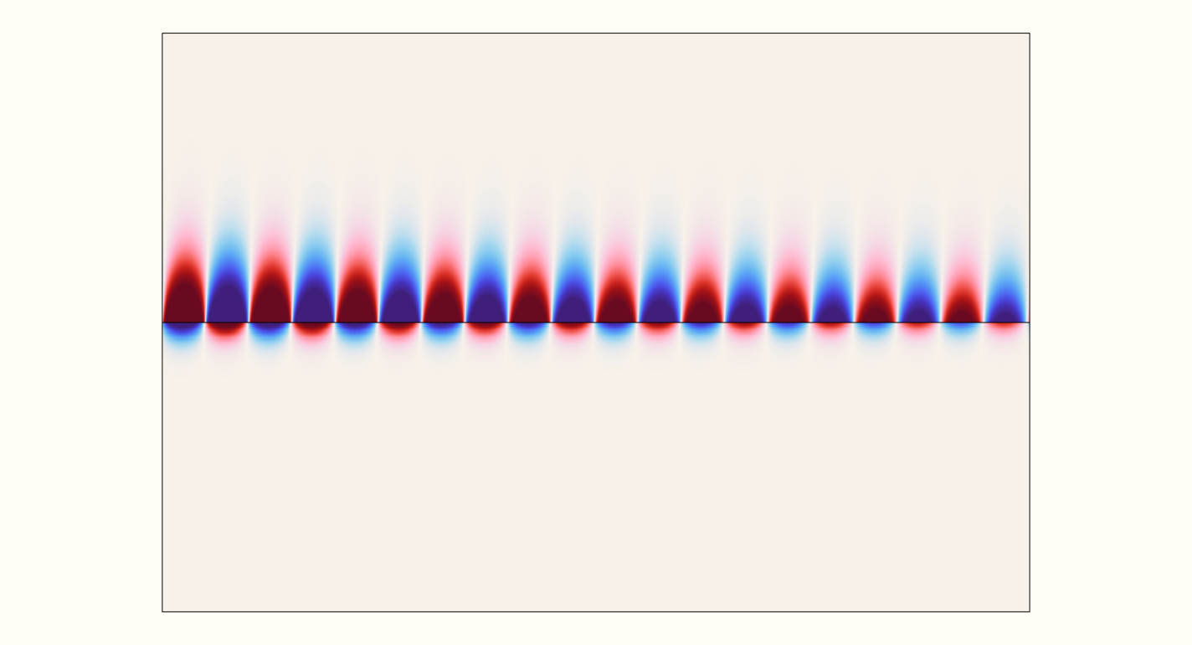


What are plasmons?
$$λ_{spp}$$
$$λ_{photon}$$
Shrinking Light

Slide 5
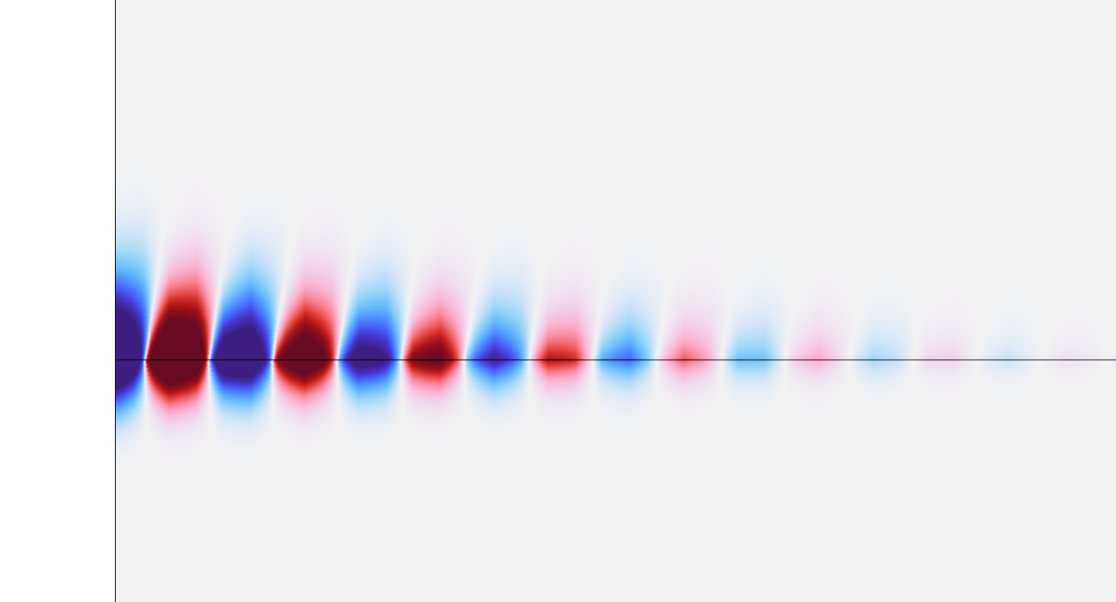

Remember the higher-order terms?
Dielectric
$$λ_{spp}$$
Metal
Is the Point-dipole approximation still valid?

Slide 6
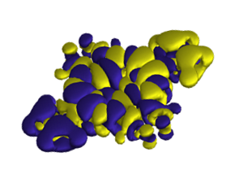

Decay Rate: In Structures - Full
Ingredients:
Molecular structure (Wavefunctions)
Green’s tensor (EM-structure)
1
2
$$Purcell Enhancement= \frac{ΓStructure}{ΓVacuum}$$
3
Molecule
Molecule
EM-structure
Molecule

Slide 7
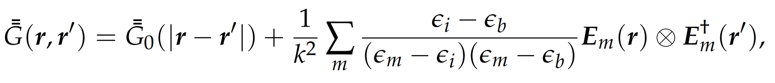

In search of the ingredients
Molecule
Green’s tensor
Use a quantum chemistry package such as Gaussian (TD-DFT)
Extract useful data
Construct current transition densities:
$$j\left(\vec{r}\right)=ψ_{e}∇ψ_{g}$$
Use a newly developed method called GENOME
Build the structure in COMSOL Multiphysics
Calculate eigen-permittivity modes
Expand Green’s tensor as a sum of these modes

Slide 8
Results

Slide 9

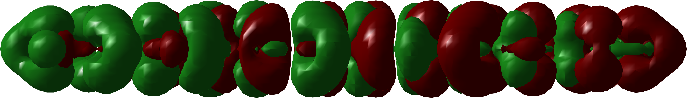

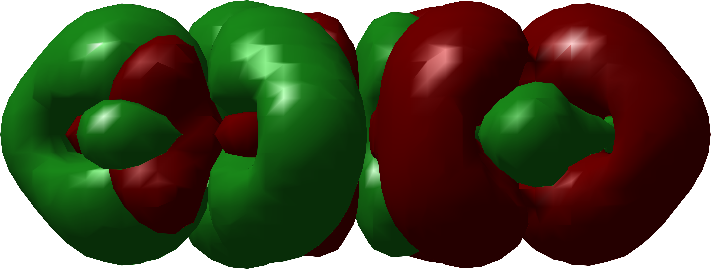
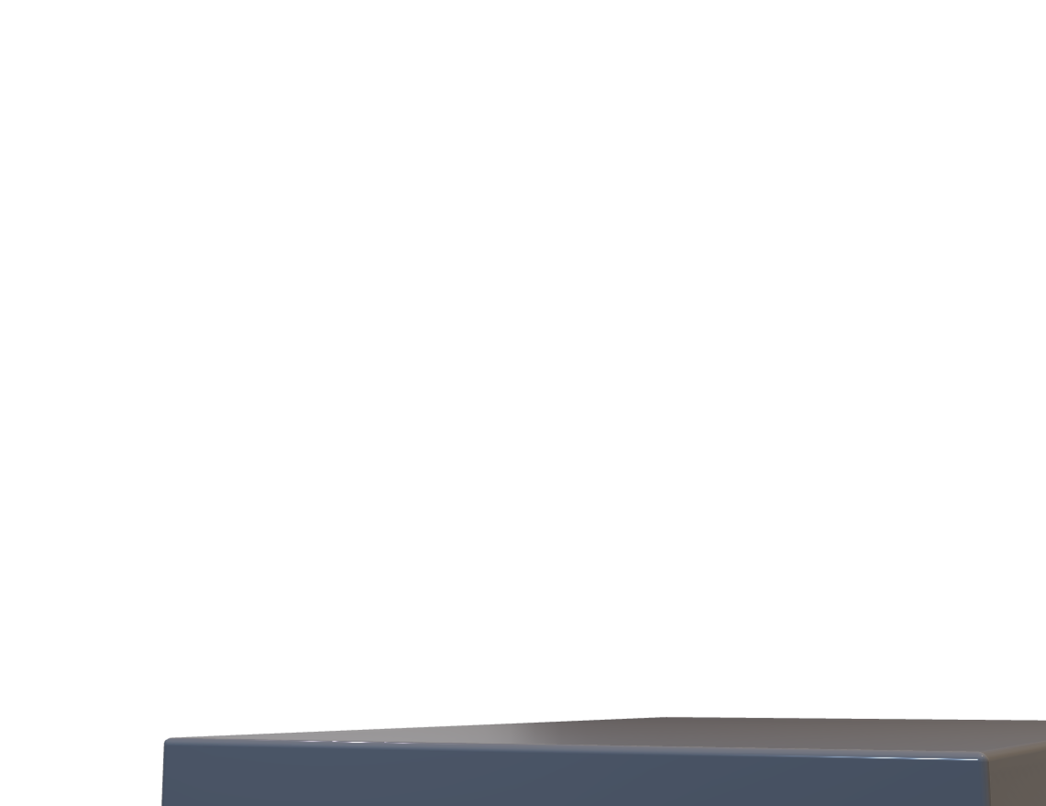
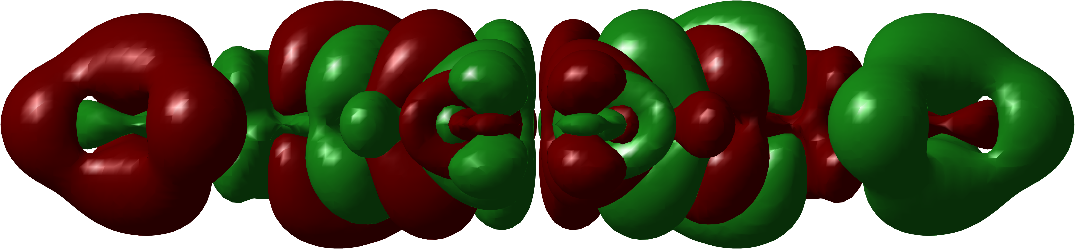
Systems of Study

Slide 10
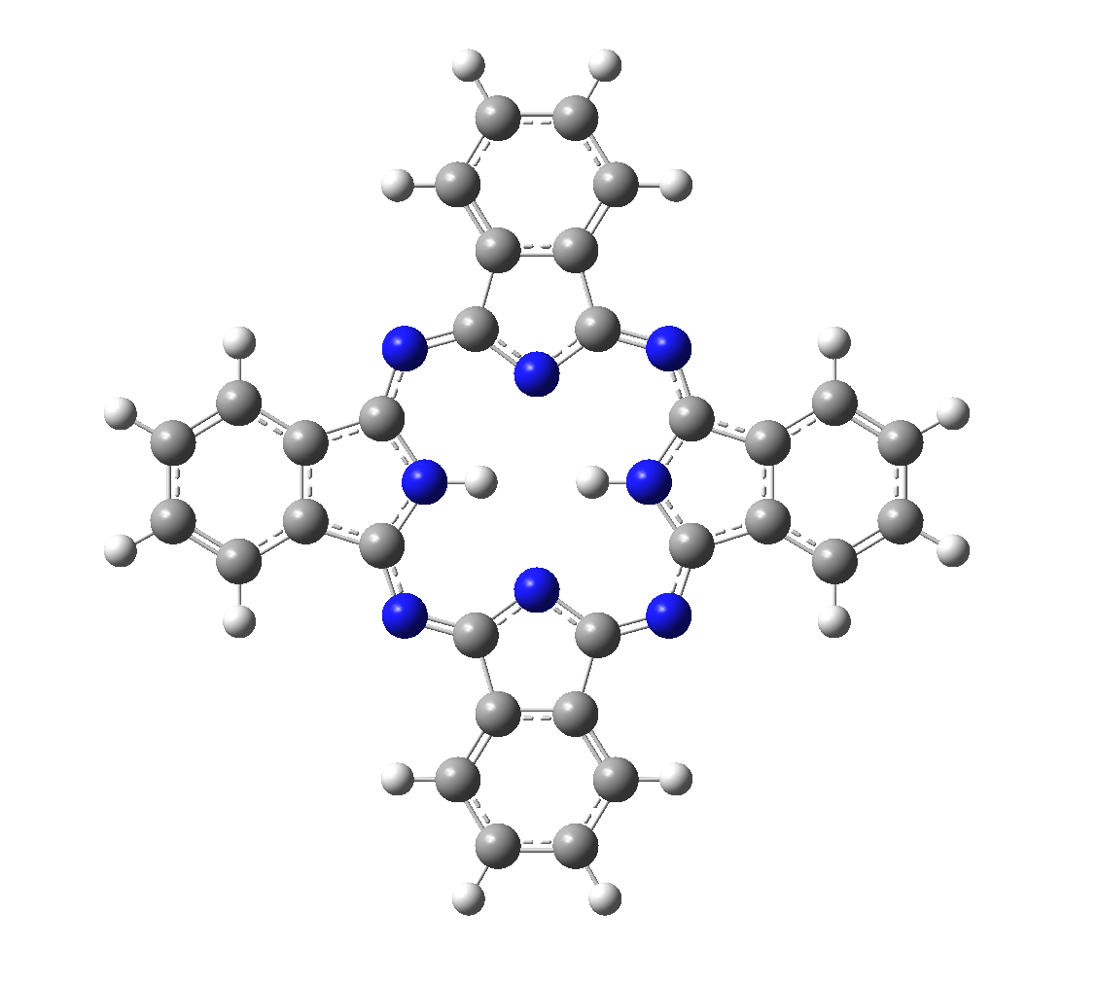
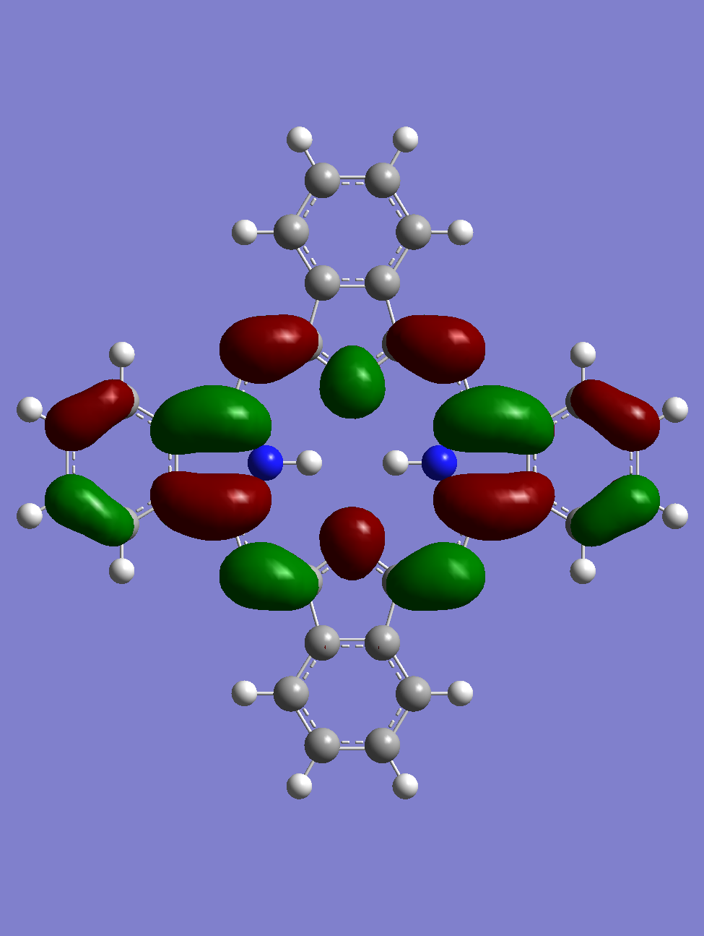
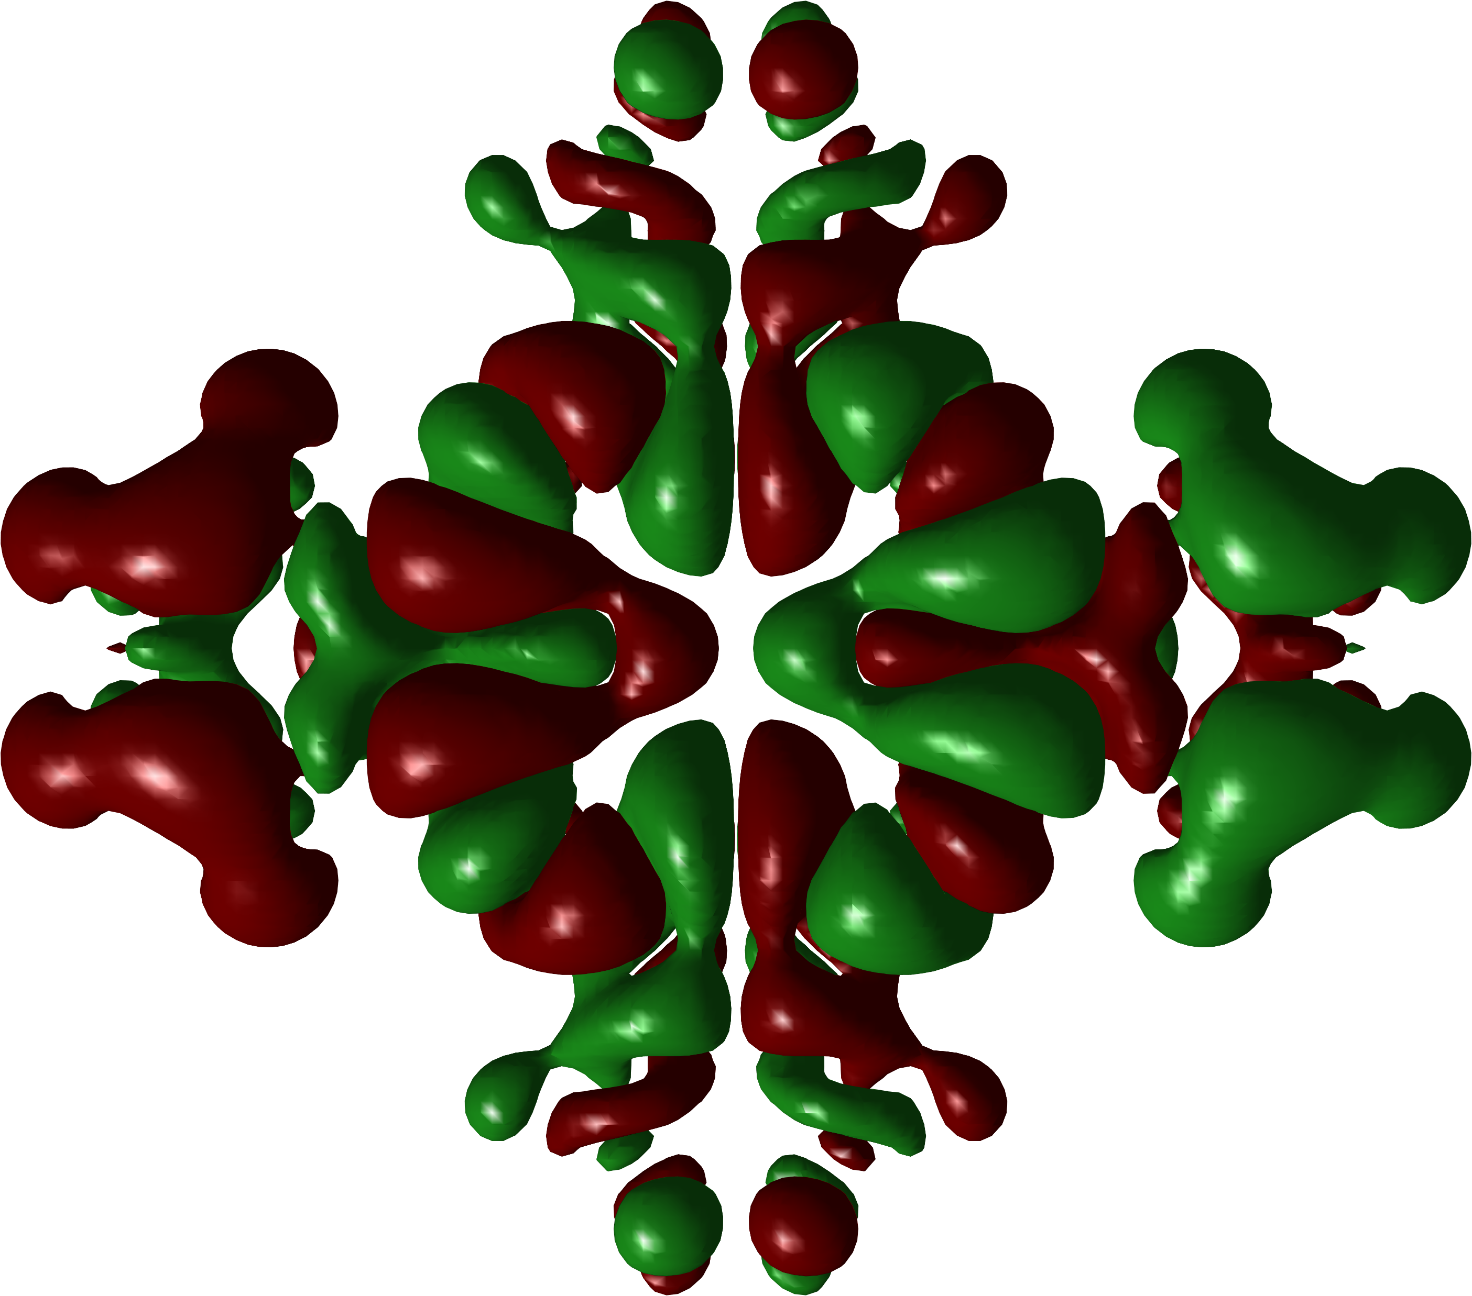
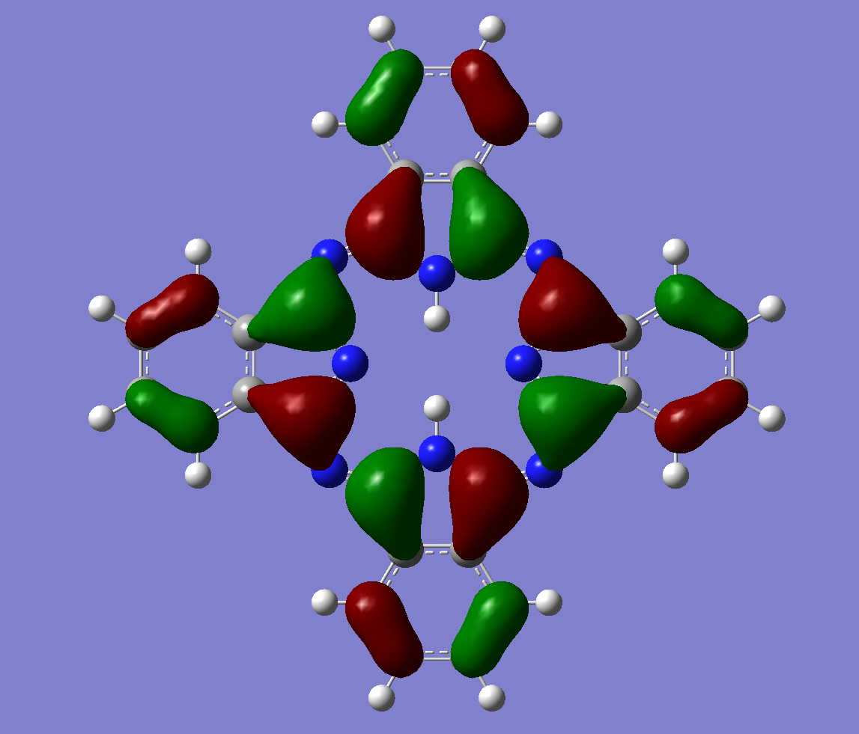
STM – Tip // H₂Pc molecule
Nitrogen Atom
652 nm
28,5 nm
Carbon Atom
Top view
Hydrogen Atom
2 nm
1 nm
Transition Density

Slide 11
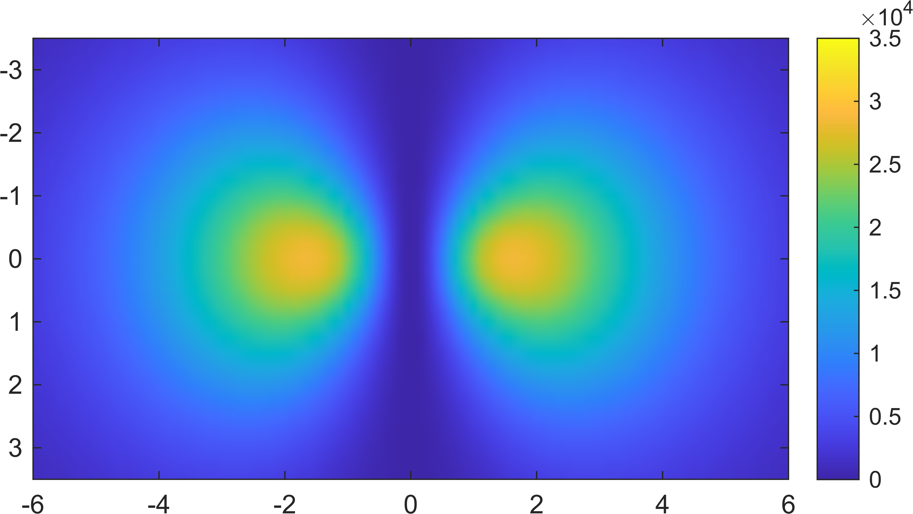
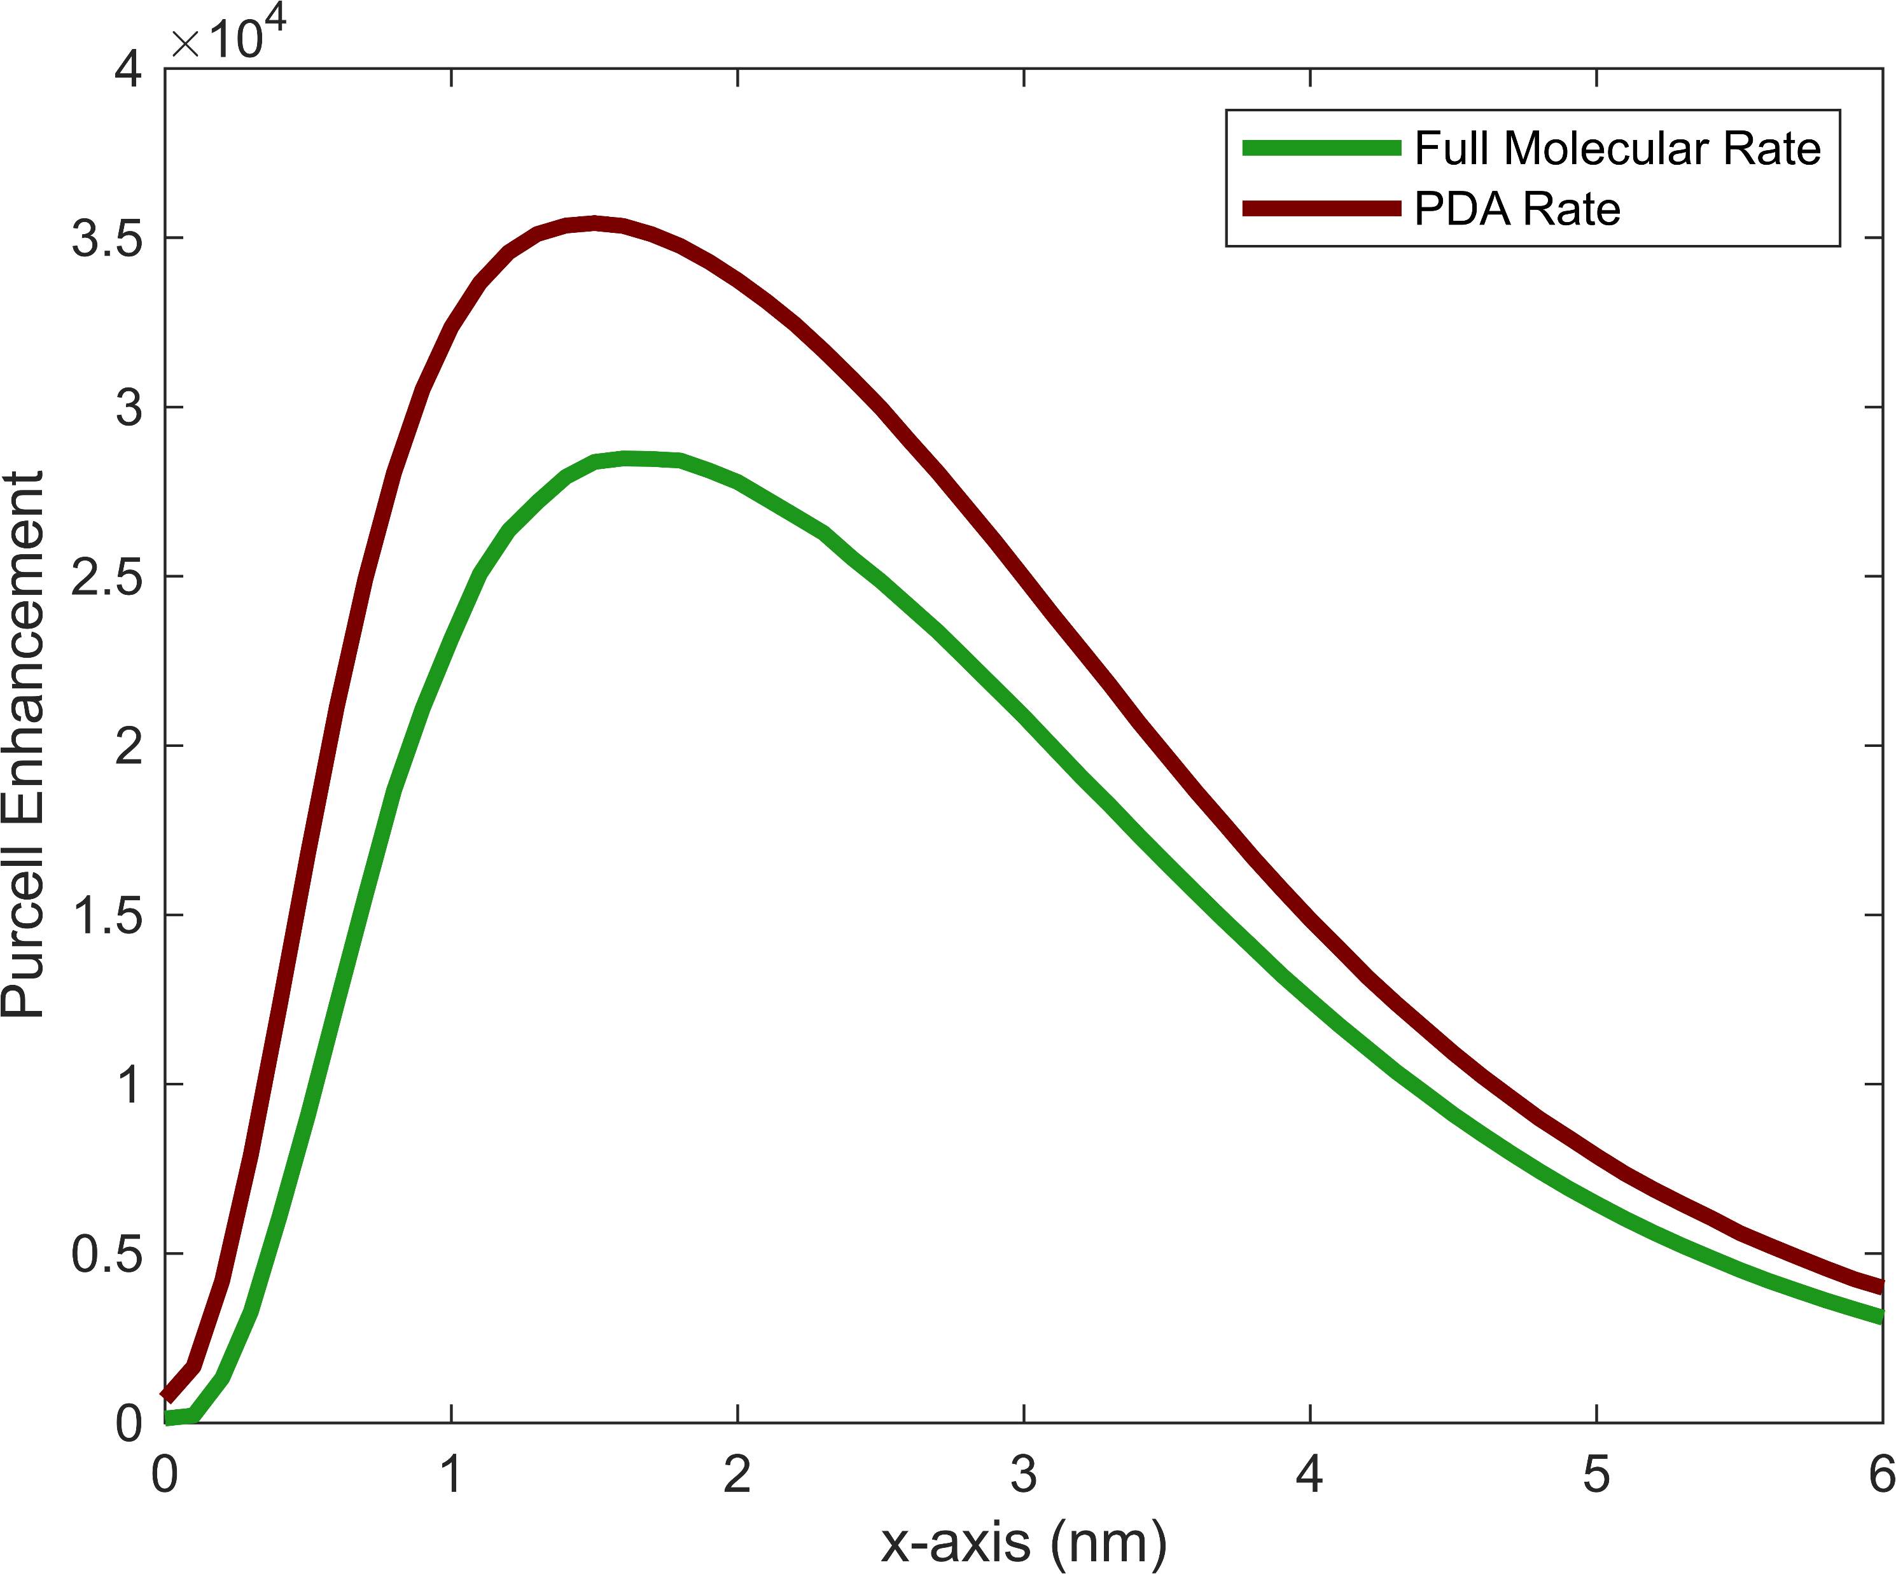
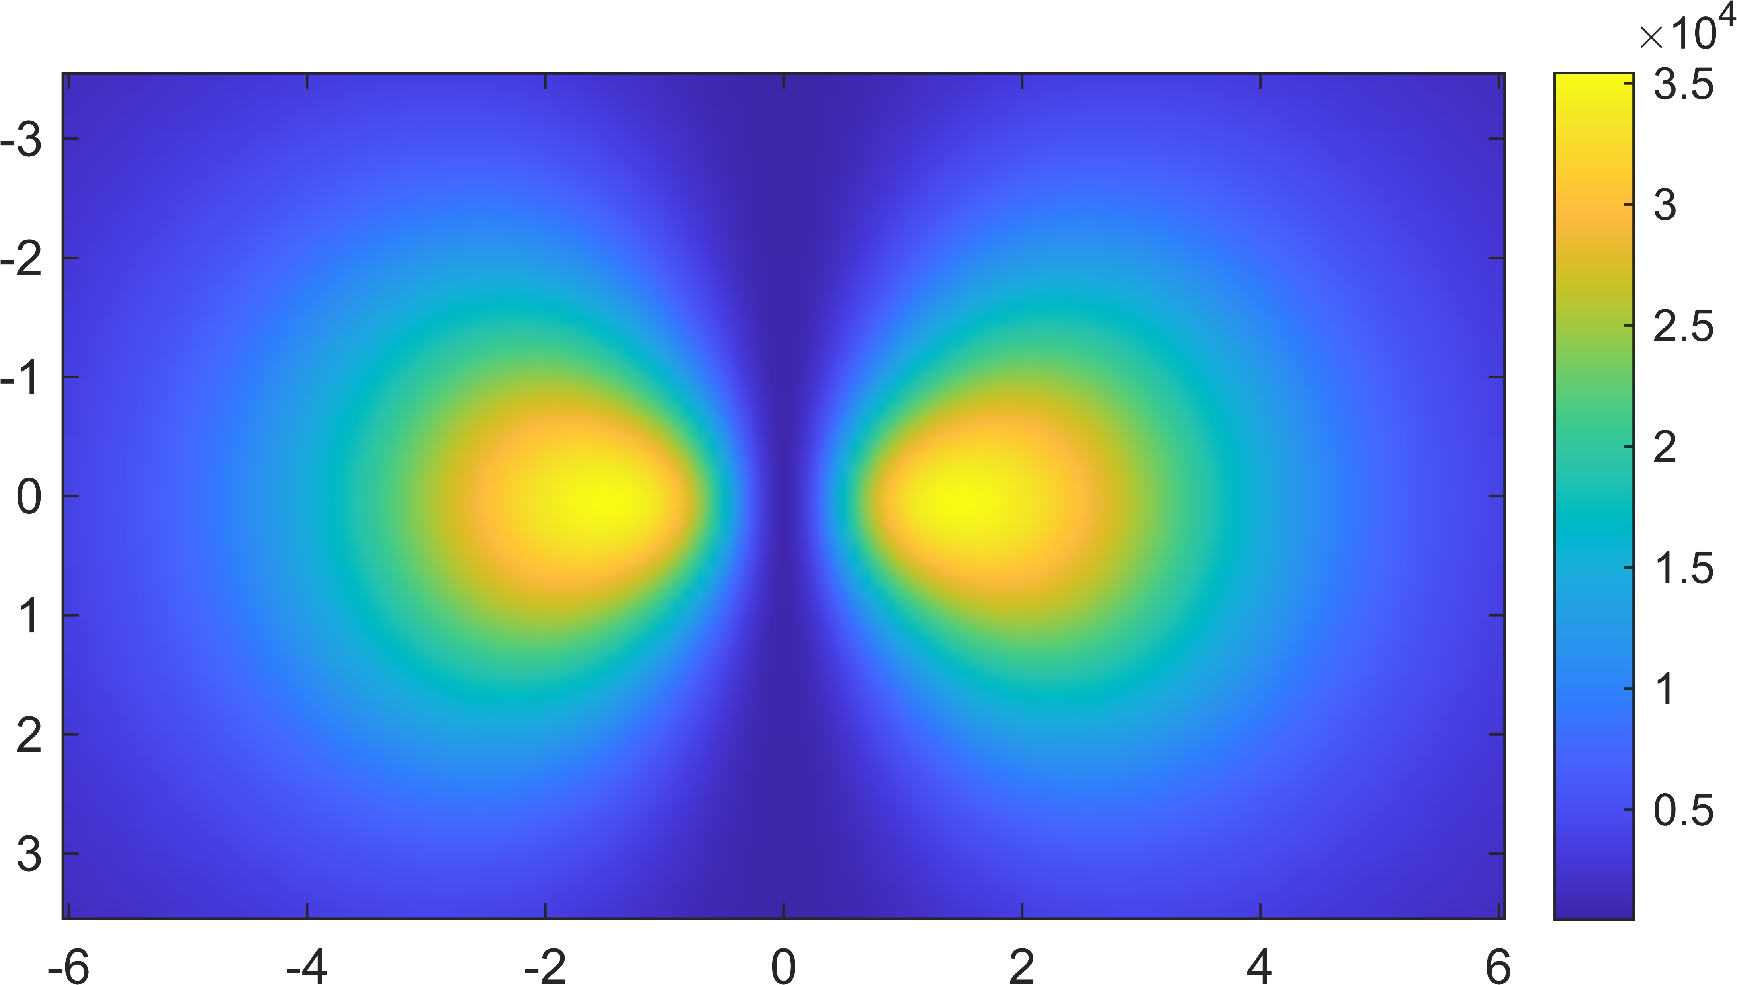
STM – Silver Tip // H₂Pc molecule
Purcell Enhancement
Molecule
25% Error
nm
PDA
nm
0,2 nm
nm

Slide 12
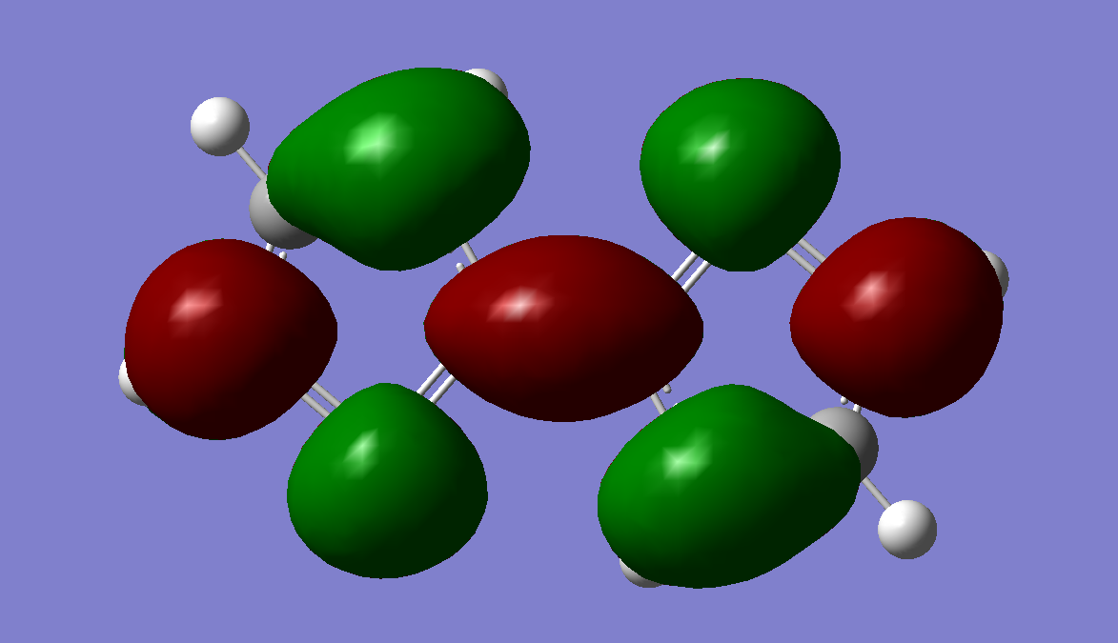
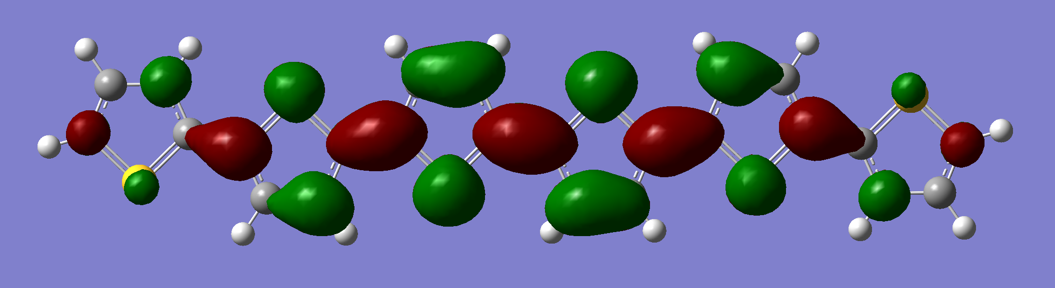
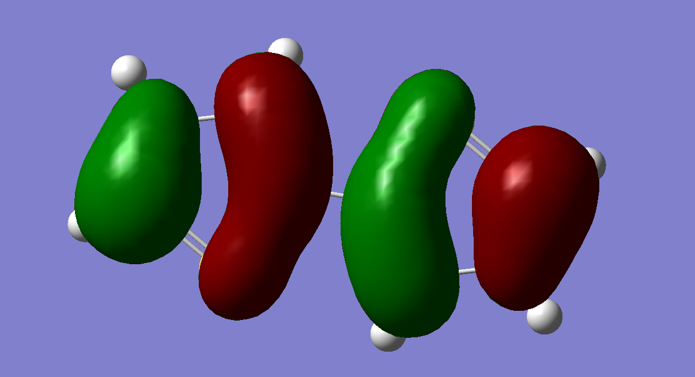
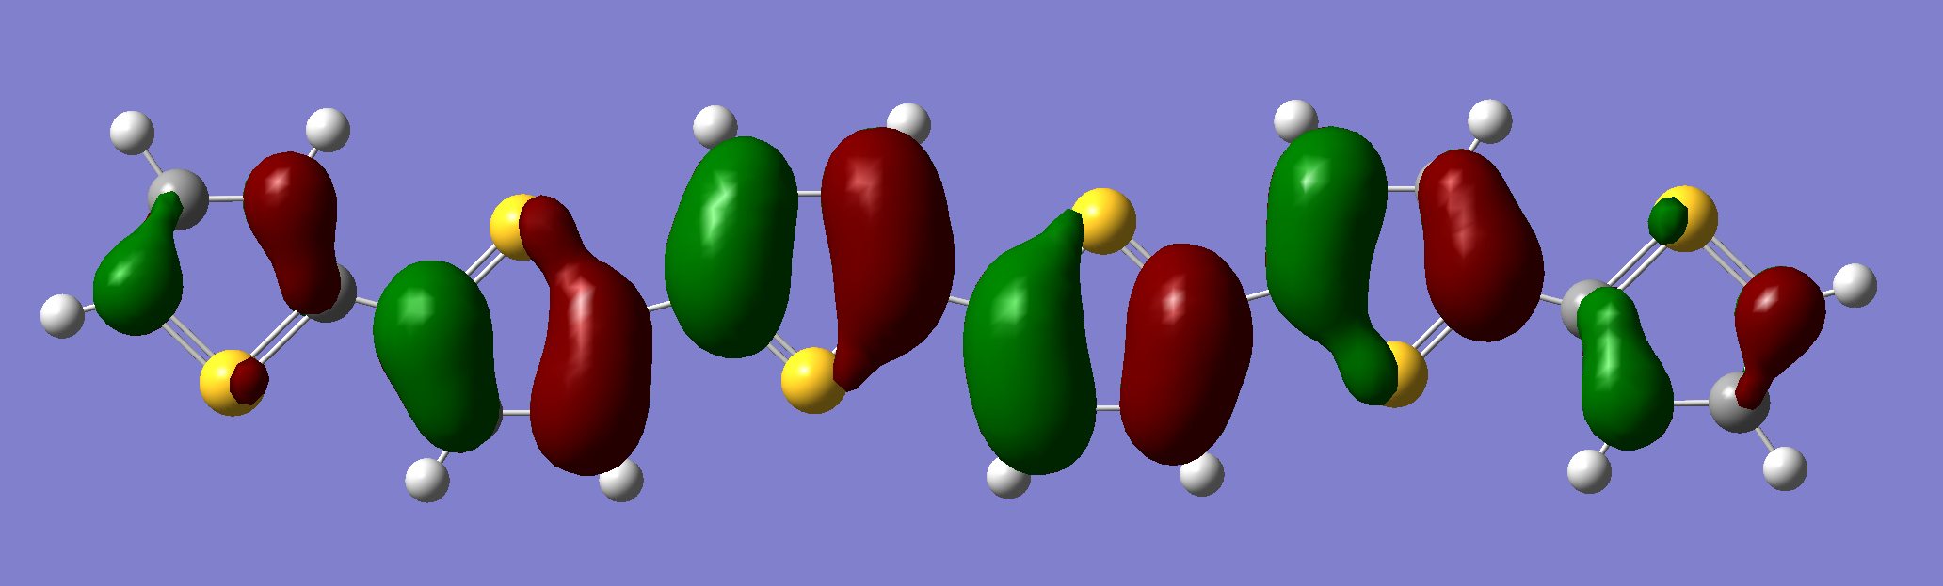
Gold Nanosphere // OligoThiophenes
DiThiophene T2
SexiThiophene T6
344 nm
517 nm
0,75 nm
2,2 nm

Slide 13
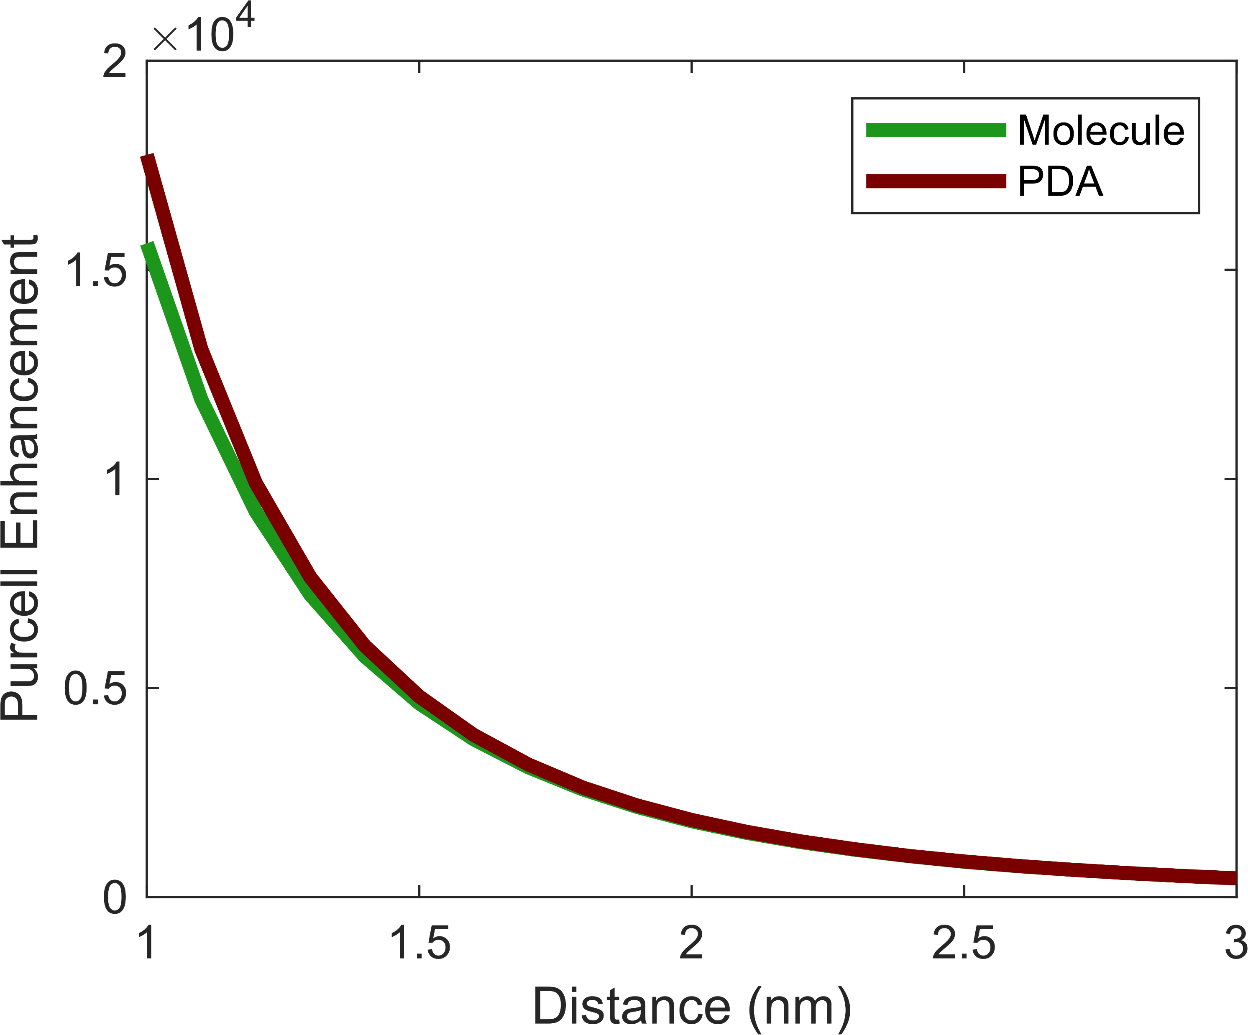
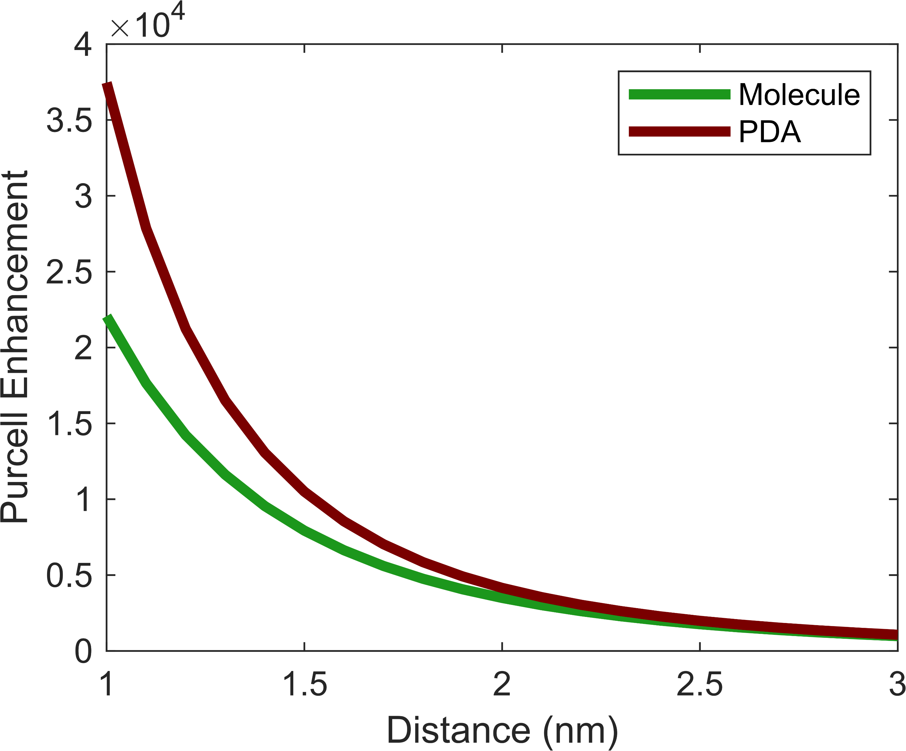

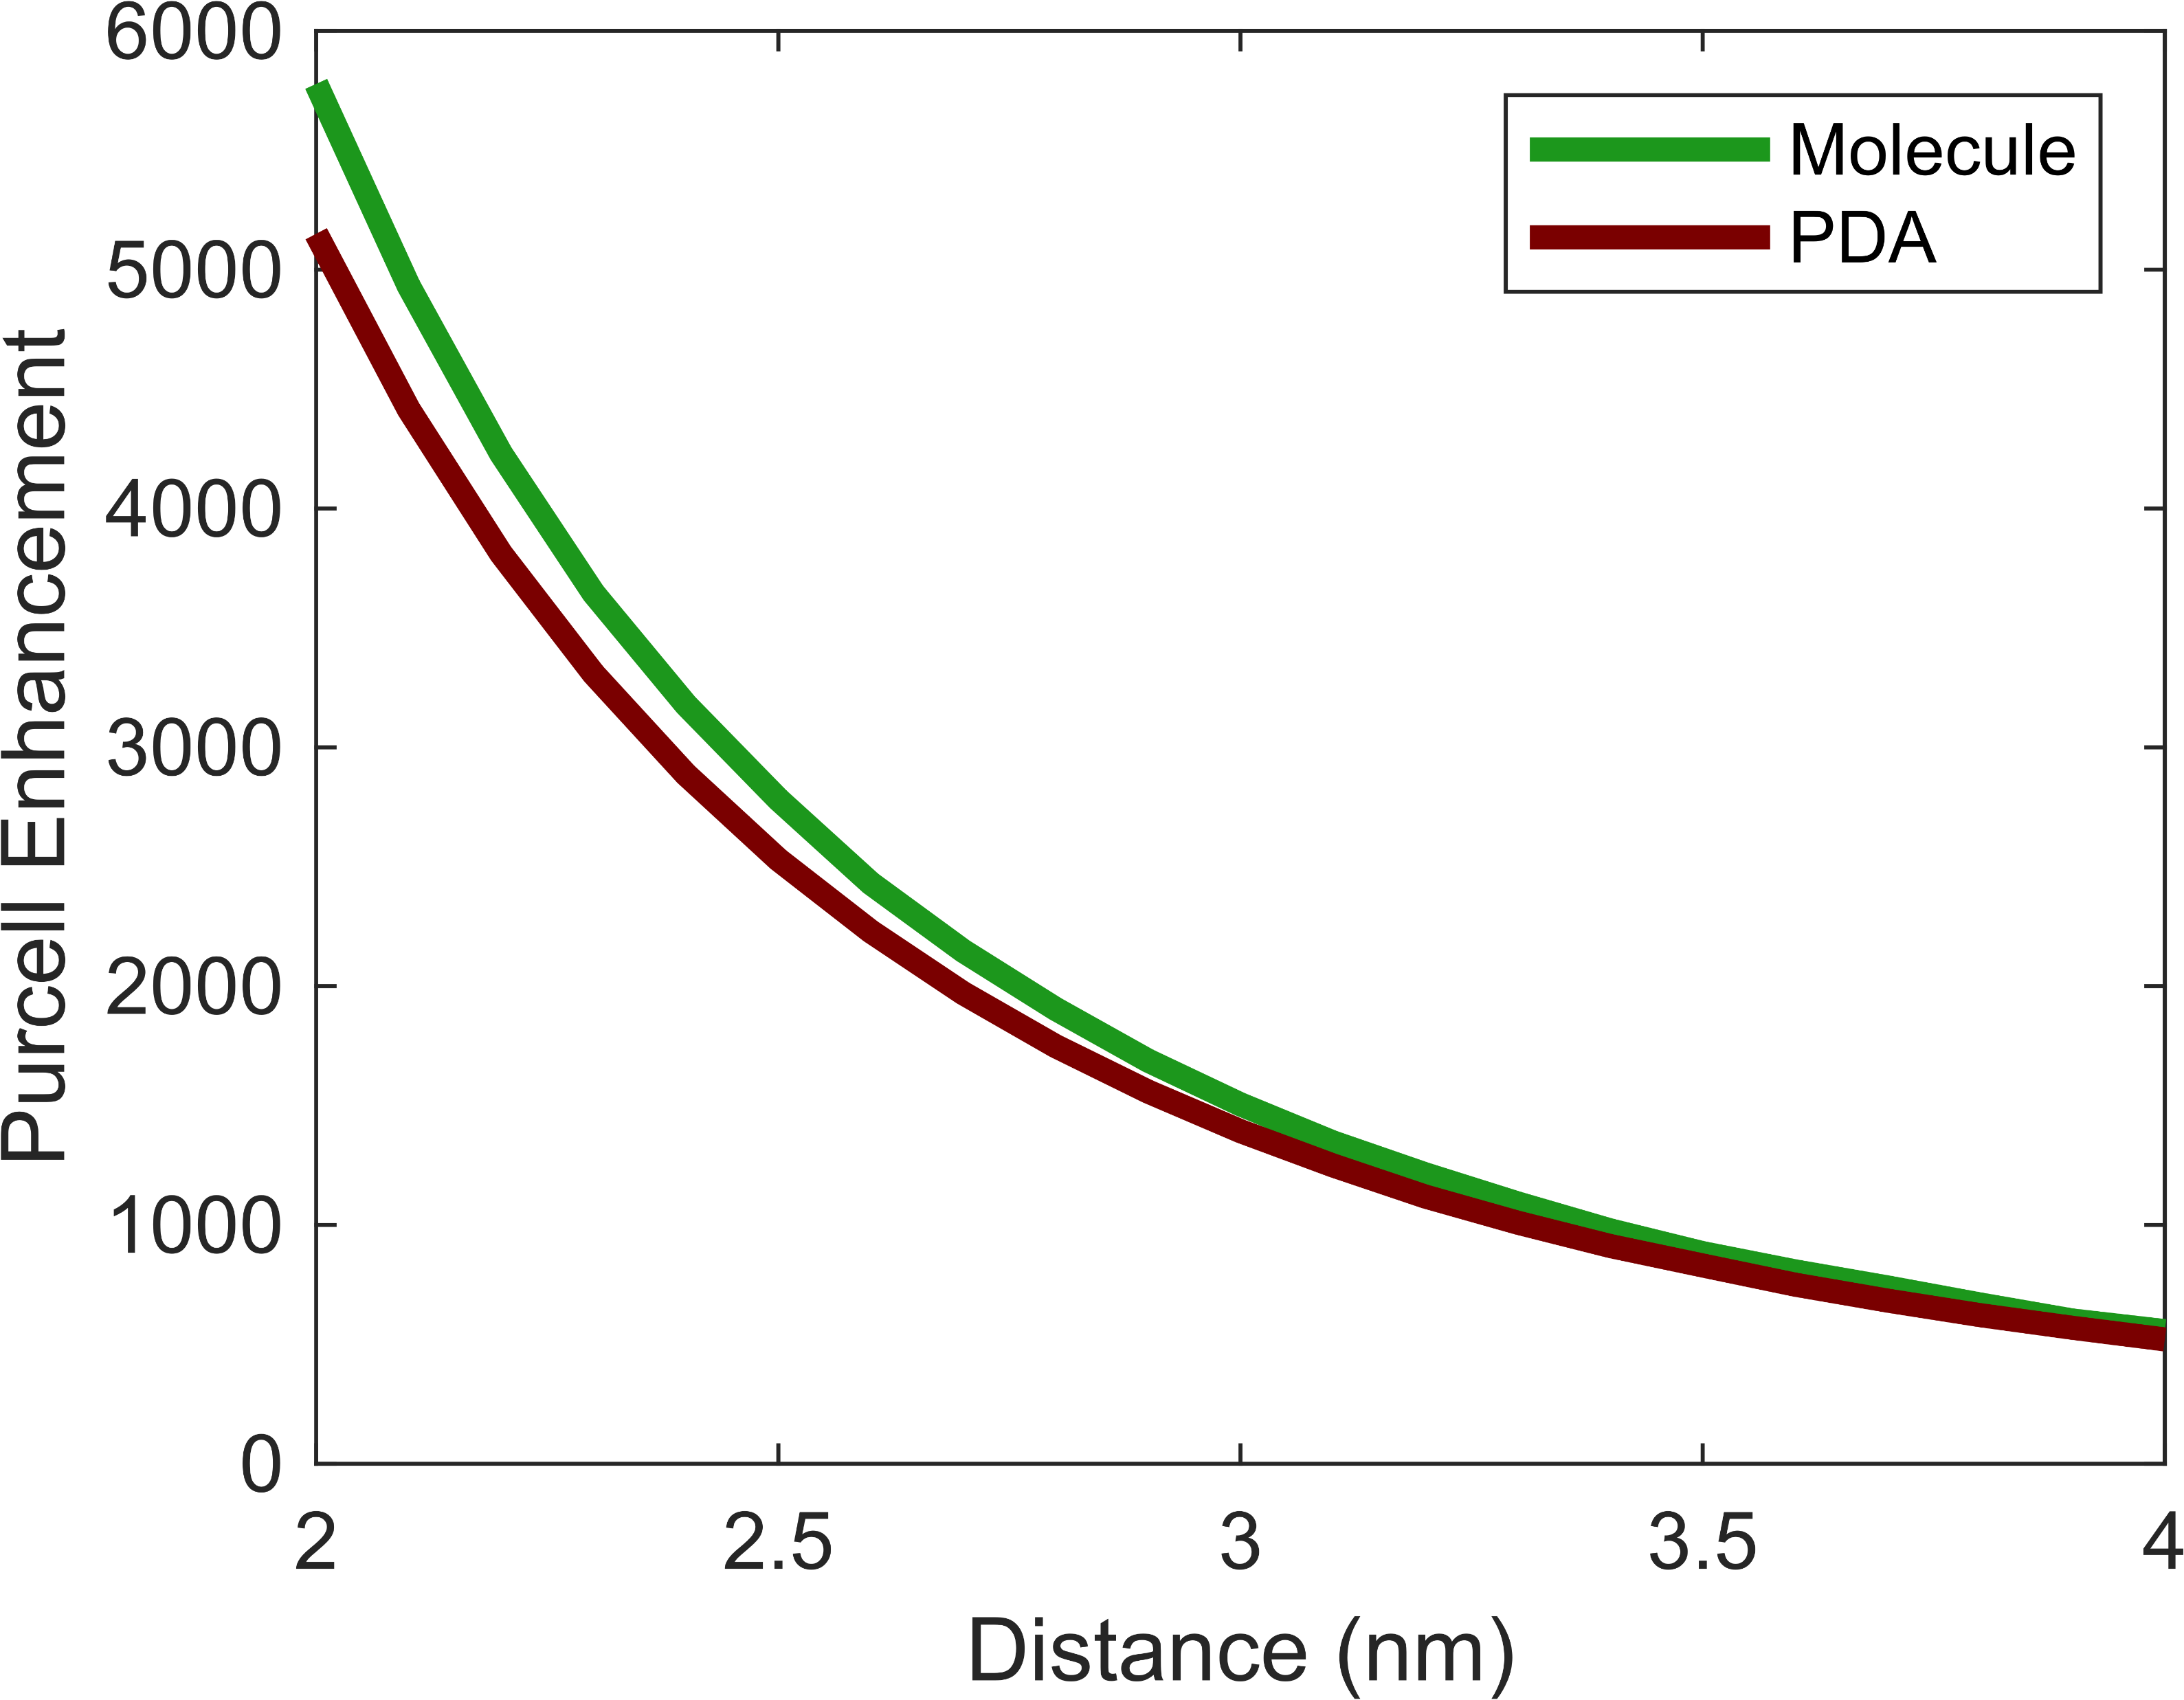
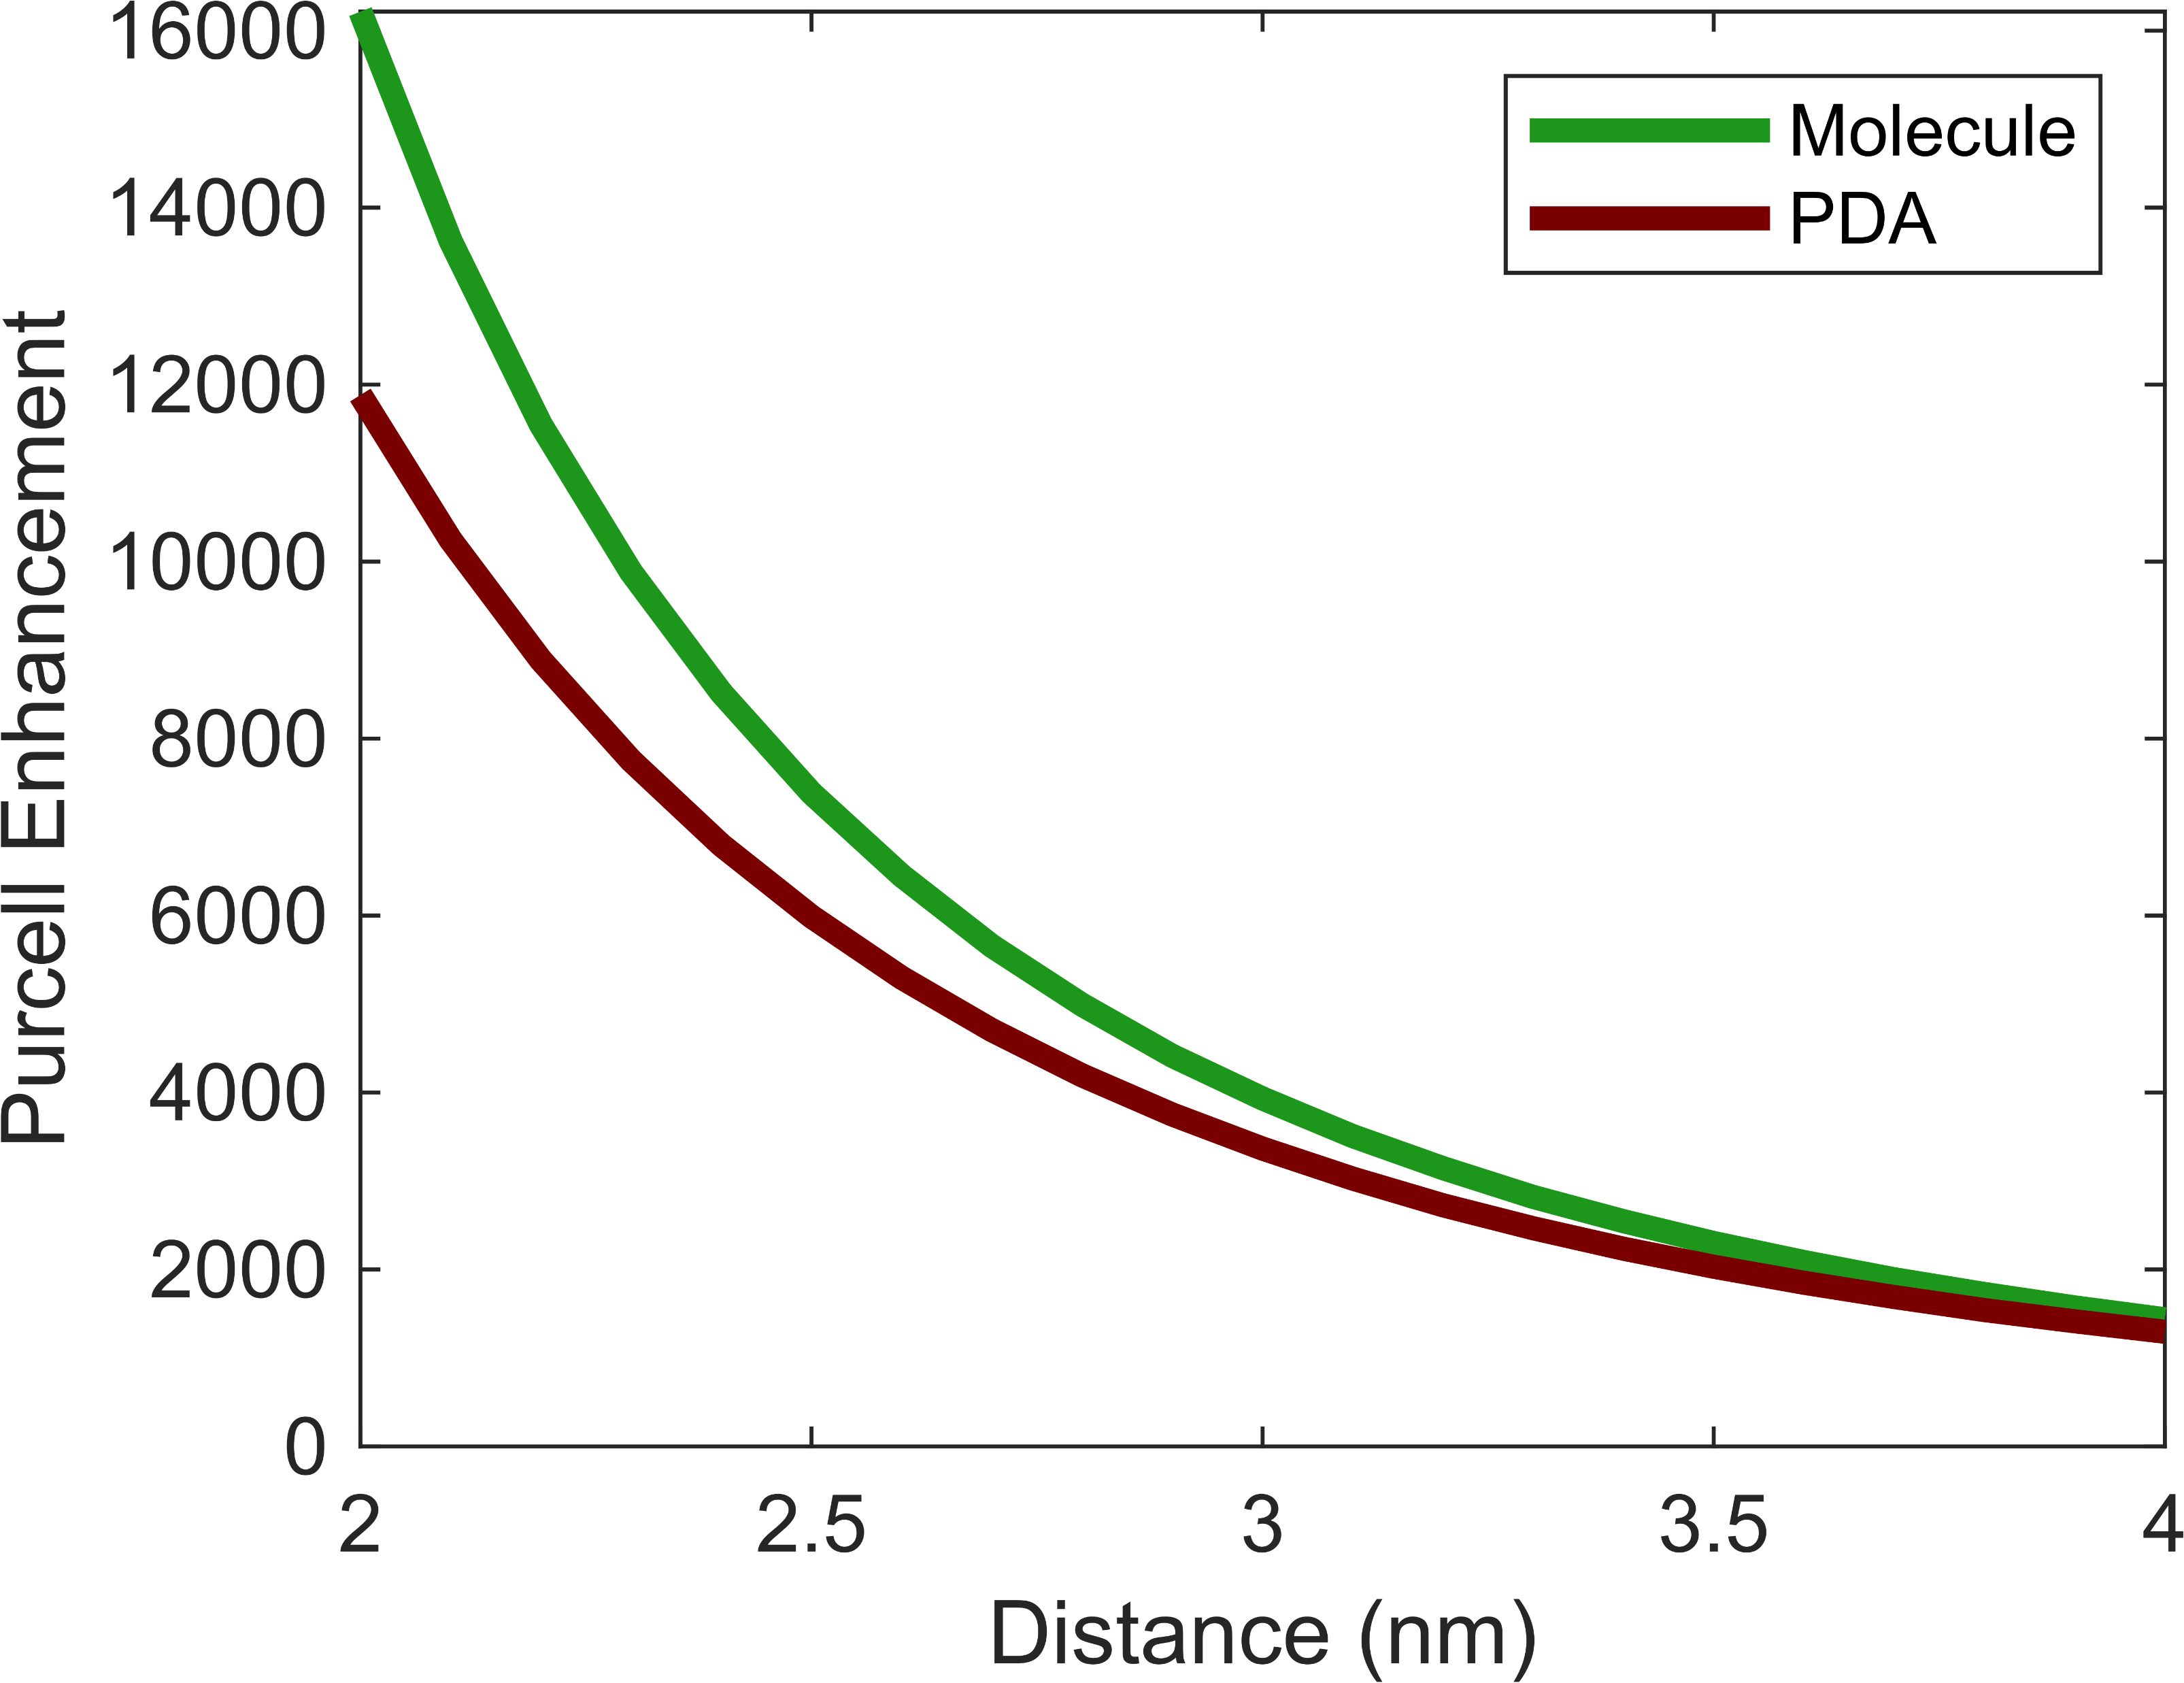
Gold Nanosphere // OligoThiophenes
T2
T6
Tangent
Normal
20% Error
70% Error
T
T
T
N
15% Error
25% Error
N
N

Slide 14
Conclusion

Slide 15

A new method was introduced that offers full molecular rate enhancement calculation
Plasmons strongly enhance decay rates
The Point-dipole approximation is very solid in describing the qualitative enhancement
The quantitative aspect of the PDA starts to fail at the very proximity of plasmonic surfaces
Actions de Recherche Concentrées ARC-21/25 / UMONS2

Slide 16
Prospective

Slide 17
The study of forbidden transitions’ activation where the transition dipole moment is zero
Explain the failure of the PDA through multipolar expansion terms
Study multipolar interferences
Look out for patterns/rule of thumbs that can help us predict in advance whether the PDA will fail
Actions de Recherche Concentrées ARC-21/25 / UMONS2

Slide 18
